Slide 1
VLSM and CIDR
CCNA Exploration Semester 2
Chapter 6

Slide 2
Topics
Revision of classful and classless IP addressing
Revision of VLSM and benefits
Use of Classless Interdomain Routing (CIDR)

Slide 3
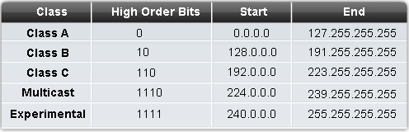
Classful addressing

Slide 4
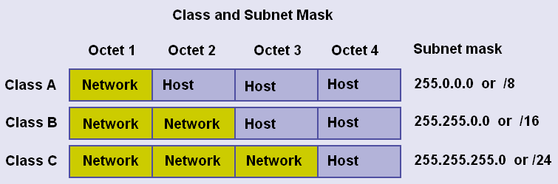
Network part and host part

Slide 5
Classful networks
Address class | First octet range | Number of networks | Hosts per network
Class A | 0 to 127 | 128 (less 0 and 127) | 16,777,214
Class B | 128 to 191 | 16,348 | 65,534
Class C | 192 to 229 | 2,097,152 | 254

Slide 6
Some Class A owners
General Electric Company US Defense (various) IBM DoD Intel AT&T Bell Laboratories Xerox Corporation Hewlett-Packard Company Digital Equipment Corp Apple Computer Inc. MIT Ford Motor Company | UK Ministry of Defence UK Social Security Dept AT&T Global Network Halliburton Company Eli Lily and Company Bell-Northern Research Prudential Securities Inc. E.I. duPont de Nemours Merck and Co., Inc. DoD Network Information U.S. Postal Service

Slide 7
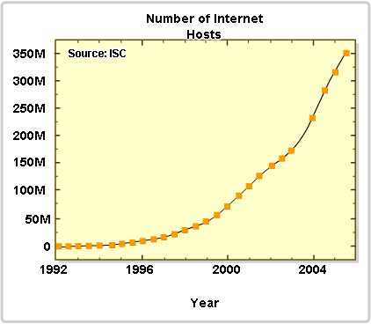
Not enough addresses
We would have run out of version 4 addresses some time ago if we still used only classful addresses.

Slide 8
Solutions
Long term – change to IP version 6.
Plenty of addresses using a different scheme
Use VLSM and CIDR to avoid wasting addresses
Use private addresses locally and NAT for internet access – lets many hosts share a few public addresses

Slide 9
Classful Subnetting
Subnetting can be used with a classful addressing system, but all subnets of a main network must have the same subnet mask. This means that they must all have the same number of hosts.

Slide 10
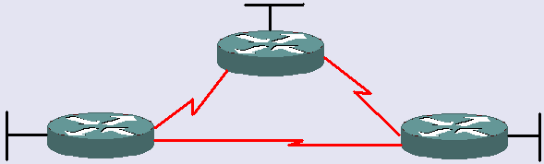
Subnet 192.168.1.0
10 hosts
26 hosts
12 hosts
Need 6 networks, up to 26 hosts.
Borrow 3 bits, /27, 255.255.255.224
Gives 8 networks, up to 30 hosts.
Point to point need 2. 28x3 = 84 wasted

Slide 11
Subnet 172.16.0.0
100 hosts
500 hosts
350 hosts
Need 6 networks, up to 500 hosts.
Borrow 7 bits, /23, 255.255.254.0
Gives 128 networks, up to 510 hosts.
Point to point need 2. 508x3 = 1524 wasted

Slide 12
Waste
Classful subnetting wastes addresses.
If you are using private addresses then you may not be bothered.
Waste of public addresses does matter.

Slide 13
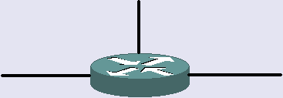
Classful routing protocol
172.16.5.1/24
192.168.3.1/24
172.16.4.1/24
What networks does it advertise out of 172.16.4.1?
172.16.5.0 and 192.168.3.0
It uses the /24 mask on the interface for subnets of 172.16.0.0

Slide 14
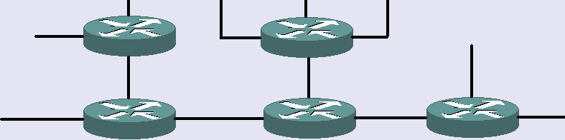
Classful routing protocol
172.16.6.0
172.16.9.0
172.16.5.0
172.16.8.0
192.168.3.0
172.16.4.0
172.16.7.0
As long as all the 172.16.0.0 subnets use the same mask and are contiguous then all is well
The subnets are listed separately in routing tables.

Slide 15
Classful routing protocol
172.16.5.1/24
192.168.3.1/24
172.16.4.1/24
What networks does it advertise out of 192.168.3.1?
172.16.0.0
It is not an interface on 172.16.0.0 therefore it uses the default mask of /16 and summarises.

Slide 16
Classful routing protocol
Fine if subnets are all the same size (same subnet mask) and are contiguous.
Cannot cope with subnets of different sizes or discontiguous subnets.

Slide 17
New system needed
But classful addressing cannot cope with the demand any more.
Classful addressing gives very large routing tables
Classless InterDomain Routing (CIDR) introduced 1993 by IETF.

Slide 18



Address allocation before CIDR
Need 10 addresses
Class C. Give them 256.
Need 200 addresses
Class C. Give them 256.
Need 500 addresses
Class B. Give them 65,536.
Need 1000 addresses
Class B. Give them 65,536.
Need 4000 addresses
Class B. Give them 65,536.

Slide 19
Address allocation with CIDR
Need 10 addresses
/28. Give them 16.
Need 200 addresses
/24. Give them 256.
Need 500 addresses
/23. Give them 512.
Need 1000 addresses
/22. Give them 1024.
Need 4000 addresses
/20. Give them 4096.

Slide 20
Routing tables
Before CIDR all known classful networks had to be listed separately
2113628 potential classful networks (though default routes could help)
With CIDR networks can be aggregated into groups and summary routes put into routing tables.

Slide 21
VLSM
Variable length subnet masks (VLSM) go with CIDR
When subnetting, you do not have to give all the subnets the same mask.
You can “subnet the subnets” and have different sizes of subnet.
Fit the addressing requirements better into the address space – less space needed.

Slide 22
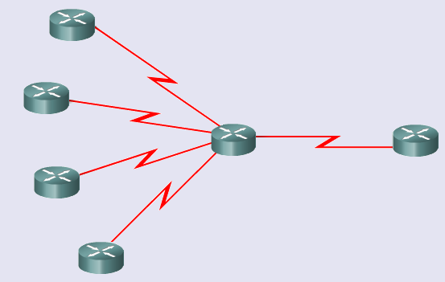
Route summarization
201.1.0.0/22
201.1.4.0/23
Advertise?
201.1.6.0/24
201.1.7.0/24

Slide 23
Route summarization
Octet 3 in binary
00000000
00000100
00000110
00000111
201.1.0.0/22
201.1.4.0/23
201.1.6.0/24
201.1.7.0/24
Same
Difference starts here
Same
Difference starts here
21 bits the same so use /21 for summary

Slide 24
Route summarization
201.1.0.0/22
Advertise
201.1.0.0/21
201.1.4.0/23
201.1.6.0/24
Summary mask is less than individual masks
201.1.7.0/24

Slide 25
Route summarisation
What address would summarise:
  170.16.0.0/16
  170.17.0.0/17
  170.17.128.0/17
  15 the same altogether
  170.16.0.0/15
Octet 2 in binary
00010000
00010001
00010001
7 the same here

Slide 26
Classless routing protocol
With classless addressing you cannot tell the mask from the address.
You need to be told the mask every time.
Routers need a routing protocol that includes subnet mask information in its updates.
RIPv2, EIGRP, OSPF, IS-IS, BGP do this.

Slide 27
Summary routes
You can create static summary routes.
Dynamic routes can be summarised.
Classless routing protocols can forward both.
Classful routing protocols do not because the receiving router would not recognise them.

Slide 28
Subnetting the subnet
172.16.0.0/16
Borrow 3 bits from octet 3
Gives 2³ = 8 subnets
Mask 255.255.224.0 or /19
How do we get the network addresses?
172.16.0.0
172.16.32.0
172.16.64.0
172.16.96.0
172.16.128.0
172.16.160.0
172.16.192.0
172.16.224.0

Slide 29
Subnetting 172.16.0.0/16
Borrowing from octet 3
Write octet 3 of mask in binary
172.16. 0 .0
172.16. 32 .0
172.16. 64 .0
172.16. 96 .0
172.16.128.0
172.16.160.0
172.16.192.0
172.16.224.0
mask | 11100000
Use all possible combinations of subnet bits for addresses
subnet 1 subnet 2 subnet 3 etc. | 00000000 00100000 01000000

Slide 30
Another way of looking at it
Row 1 = Bits borrowed
Row 2 = Prefix (16 + bits borrowed for octet 3)
Row 3 = Value of bit. Add this to get next network
Row 4 = Add row 3 values so far to get mask
1 | 2 | 3 | 4 | 5 | 6 | 7 | 8
17 | 18 | 19 | 20 | 21 | 22 | 23 | 24
128 | 64 | 32 | 16 | 8 | 4 | 2 | 1
128 | 192 | 224 | 240 | 248 | 252 | 254 | 255

Slide 31
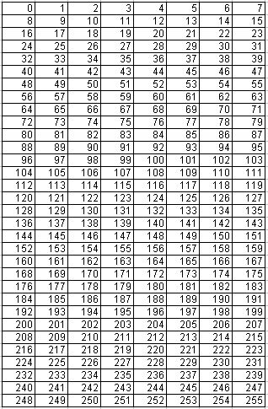
Yet another way
Show all 256 values in the address space – here it is octet 3
Borrow 1: slice
Borrow 2: slice
Borrow 3: slice
0, 32, 64, 96, 128, 160, 192, 224

Slide 32
Subnetting the subnet
So far so good.
Borrowed 3 bits, got 8 equal sized subnets.
Now take subnet 172.16.192.0/19 and borrow 2 more bits
New mask is /21
172.16.0.0
172.16.32.0
172.16.64.0
172.16.96.0
172.16.128.0
172.16.160.0
172.16.192.0
172.16.224.0
mask | 11111000

Slide 33
Subnetting 172.16.192.0/19
Working in octet 3
2 more bits borrowed
2² = 4 sub-subnets
Total of 5 bits borrowed
172.16.192.0
172.16.200.0
172.16.208.0
172.16.216.0
mask | 11111000
8 more would be 224 but that is not in 172.16.192.0/19
This bit is increased for each subnet address – add 8 each time

Slide 34
Another way of looking at it
Row 1 = Bits borrowed
Row 2 = Prefix (16 + bits borrowed for octet 3)
Row 3 = Value of bit. Add this to get next network
Row 4 = Add row 3 values so far to get mask
1 | 2 | 3 | 4 | 5 | 6 | 7 | 8
17 | 18 | 19 | 20 | 21 | 22 | 23 | 24
128 | 64 | 32 | 16 | 8 | 4 | 2 | 1
128 | 192 | 224 | 240 | 248 | 252 | 254 | 255

Slide 35
Yet another way
Subnetting 172.16.192.0/19
Borrow 1 more: slice
Borrow 2 more: slice
192, 200, 208, 216

Slide 36
Subnetting the subnet
172.16.0.0/19
172.16.32.0/19
172.16.64.0/19
172.16.96.0/19
172.16.128.0/19
172.16.160.0/19
172.16.192.0/19
172.16.224.0 /19
172.16.192.0/21
172.16.200.0/21
172.16.208.0/21
172.16.216.0/21

Slide 37
Exercise
Subnet 172.16.0.0/16 by borrowing 4 bits.
Then subnet the third subnet by borrowing 2 more bits.
Write out the subnet addresses and masks.

Slide 38
Subnetting 172.16.0.0/16
172.16.0.0/20
172.16.16.0/20
172.16.32.0/20
172.16.48.0/20
172.16.64.0/20
172.16.80.0/20
172.16.96.0/20
172.16.112.0 /20
172.16.128.0/20
172.16.144.0/20
172.16.160.0/20
172.16.176.0/20
172.16.192.0/20
172.16.208.0/20
172.16.224.0/20
172.16.240.0 /20
172.16.32.0/22
172.16.36.0/22
172.16.40.0/22
172.16.44.0/22

Slide 39
Practise
Practise subnetting and summarising routes until you can do it easily.

Slide 40
The End

